Slide 1

WEB TECHNOLOGIES
Document Object Model
Prof. Pavan A C
Department of Computer Science and Engineering
Acknowledgement:
Teaching Assistants(Samved Suresh Jain and Sathyajit P)

Slide 2

HTML5,Jquery and Ajax
DOM – Document Object Model
When a web page is loaded, the browser creates a Document Object Model of the page.
The HTML DOM model is constructed as a tree of Objects.
The HTML DOM is a standard object model and programming interface for HTML. It defines:
The HTML elements as objects.
The properties of all HTML elements.
The methods to access all HTML elements.
The events for all HTML elements.

Slide 3
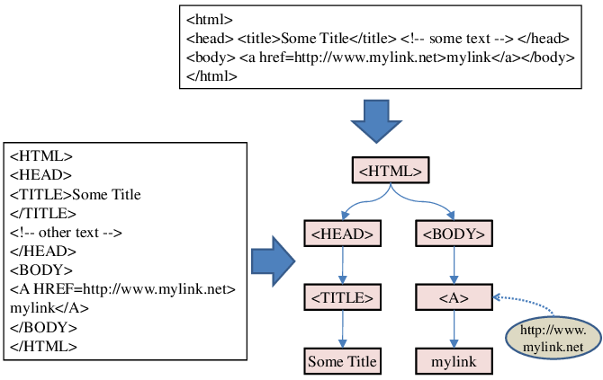
HTML5,Jquery and Ajax
DOM – Document Object Model
How DOM of a page is created -

Slide 4
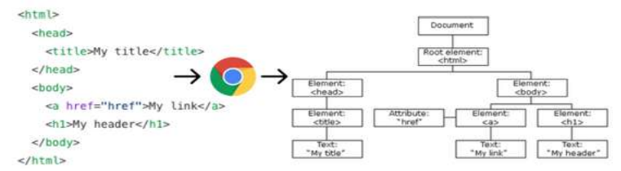
HTML5,Jquery and Ajax
DOM – Document Object Model
The Document Object Model (DOM) represents the web page and it can be manipulated. The DOM is an object-oriented representation of the web page, which can be modified with a scripting language such as JavaScript.
The DOM is not a part of the JavaScript language
The DOM is constructed from the browser and is globally accessible by JavaScript code using the document object

Slide 5
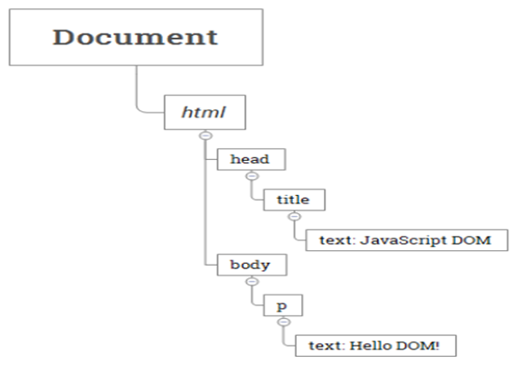
HTML5,Jquery and Ajax
DOM – Tree Representation
<html>
<head>
<title>JavaScript DOM</title>
</head>
<body>
<p>Hello DOM!</p>
</body>
</html>
In this DOM tree, the document is the root node. The root node has one child
which is the <html> element. The <html> element is called the document element.

Slide 6
Document Object Model
Drawbacks of using document.write()
The W3C Document Object Model (DOM) provides a platform- and language‑independent interface that allows programs and scripts to dynamically access and modify a document’s content, structure, and style.
The method document.write() behaves differently depending on when it is called:
If executed while the page is still loading, it inserts the specified content at the point the script is encountered, effectively appending to the document as it is being parsed.
If executed after the page has finished loading, it clears the entire document and replaces it with the new content, effectively overwriting the existing page.
In practice, document.write() is almost never used for appending to already loaded documents, because after load completion it will not add to the page, but instead overwrite it.

Slide 7
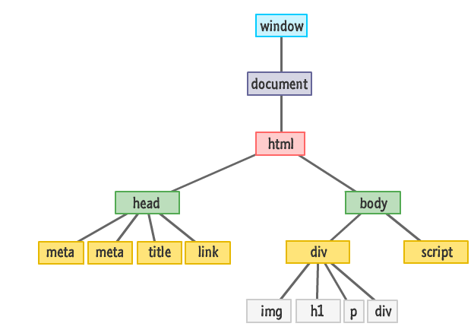
Document Object Model
Introduction to DOM
A Web page is a document. This document can be either displayed in the browser window or as the HTML source. But it is the same document in both cases.

Slide 8
DOM
Objects have properties and methods, and respond to events.
Properties are used to specify attributes or characteristics of an object.
Methods are used to specify functions an object can perform.
Events are methods corresponding to user actions.

Slide 9
Document Object Model
The document Object
The document object is the gateway to all the HTML elements and their styling properties that make up what gets shown.
We can dynamically add elements, remove them, move them around, modify attributes on them.
Any text, graphics or any information displayed on a web page is part of the document object.

Slide 10
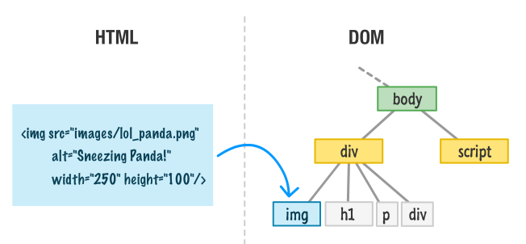
DOM
DOM Elements Are Objects
Every HTML tag, style rule, and other things that go into your page has some sort of a representation in the DOM.

Slide 11
DOM
Accessing DOM
All the DOM objects can be accessed using DOM Methods, some are given below:
document.write("string") → writes the given string directly into the document (while loading, not recommended after load).
document.getElementById(id) → returns the element with the specified id.
document.getElementsByName(name) → returns a list of all elements with a given name attribute.
document.getElementsByTagName(tag) → returns a list of all elements with a given tag name.

Slide 12
Document Object Model
Accessing Elements in DOM
Access Element By | Equivalent Selector | Method
ID | #demo | getElementByID(“demo”)
Class | .demo | getElementsByClassName(“demo”)
Tag | <tag name> like p | getElementsByTagName(“p”)
Selector (single) | Any CSS Selector | querySelector(“selector”)
Selector (all) |  | querySelectorAll(“selector”)

Slide 13
getElementById()
The document.getElementById() method returns the element of specified id.
The parameter of getElementById can be any expression that evaluates to a string.
Syntax-
document.getElementById(“#id");

Slide 14
getElementsByTagName ()
getElementsByTagName() is used to access elements and attributes using tag name.
This method will return an array of all the items with the same tag name as a NodeList object.
Syntax-
document.getElementsByTagName(tagname)

Slide 15
getElementsByName()
The getElementsByName() method returns a collection of all elements in the document with the specified name (the value of the name attribute), as a NodeList object.
Syntax-
document.getElementsByName(name);

Slide 16
Document.querySelector()
The Document method querySelector() returns the first Element within the document that matches the specified selector, or group of selectors.
If no matches are found, null is returned.
Syntax-
element = document.querySelector(selectors);

Slide 17
Document.querySelectorAll()
The Document method querySelectorAll() returns a static (not live) NodeList representing a list of the document's elements that match the specified group of selectors.
If no matches are found, null is returned.
Syntax-
elementList= parentNode.querySelectorAll(selectors);

Slide 18
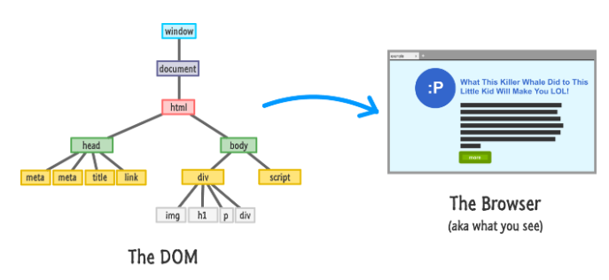
Traversing the DOM

Slide 19
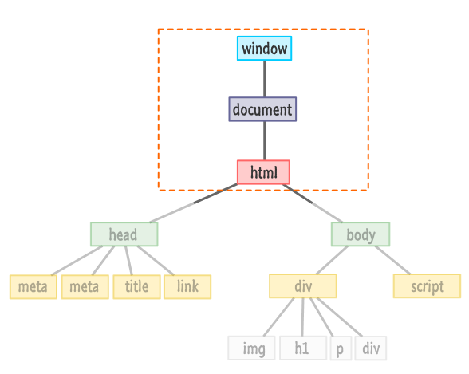
Traversing the DOM

Slide 20
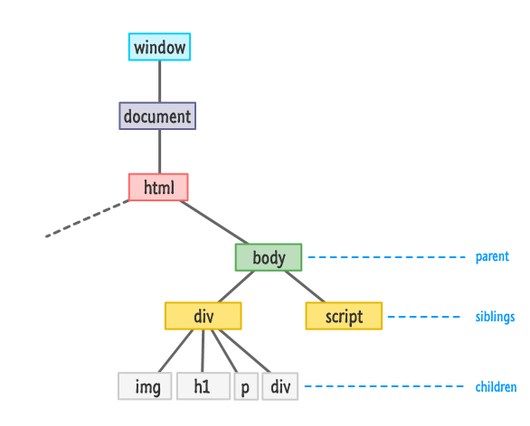
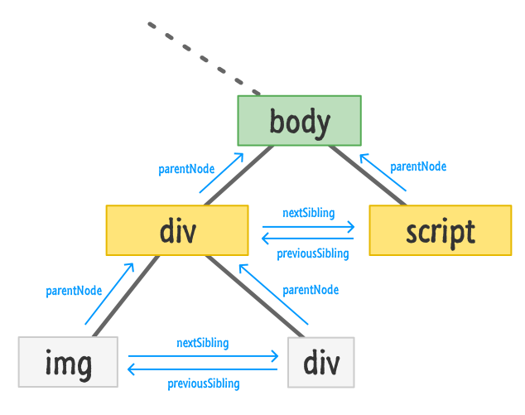
Traversing the DOM - From child node or siblings

Slide 21
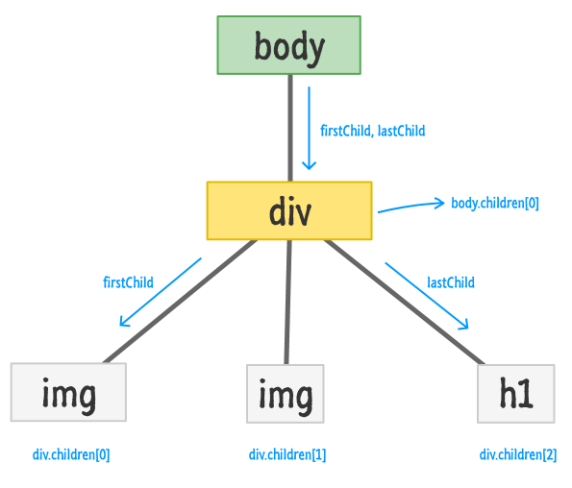
Document Object Model
Traversing the DOM - From Parent Node

Slide 22
Document Object Model
Creating Element Objects
Method | Description
document.createElement() | Create a new element node using tag
document.createTextNode() | Create a new text node
Property | Description
node.textContent or node.innerText | Get or set the text content of an element node (without HTML tags)
node.innerHTML | Get or set the HTML content enclosed in the element tag

Slide 23
Document Object Model
Manipulating Nodes in the DOM
Method | Description
node.appendChild() | Add a node as the last child of the parent element.
node.insertBefore() | Insert a node into the parentbefore a specific sibling node
node.replaceChild() | Replace an existing node with a new node
node.removeChild() | Removes child node
node.remove() | Removes a node
* node here can be document.body or any existing element in the DOM

Slide 24
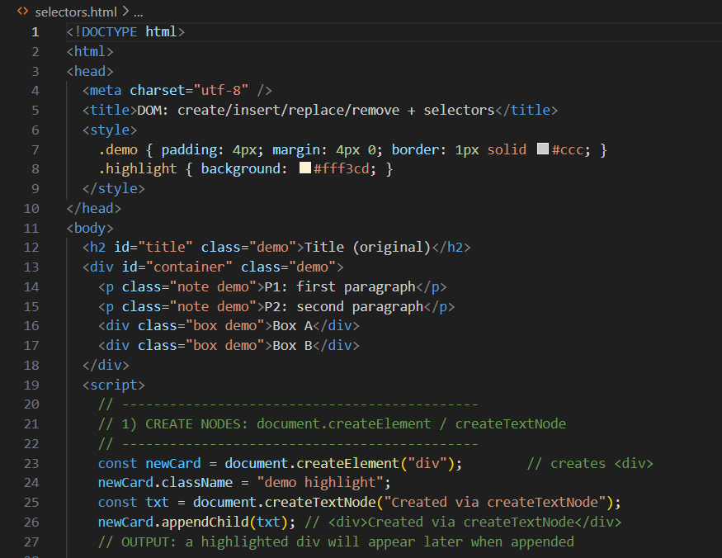
Document Object Model
Example of using DOM Methods in Code

Slide 25
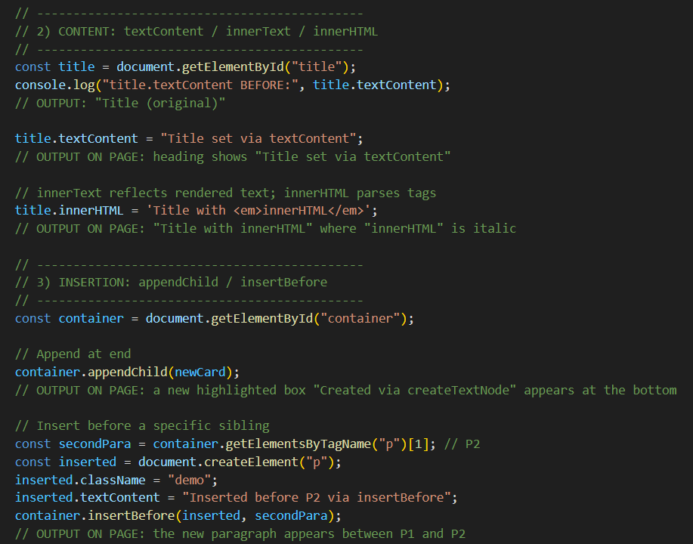
Document Object Model
Example of using DOM Methods in Code

Slide 26
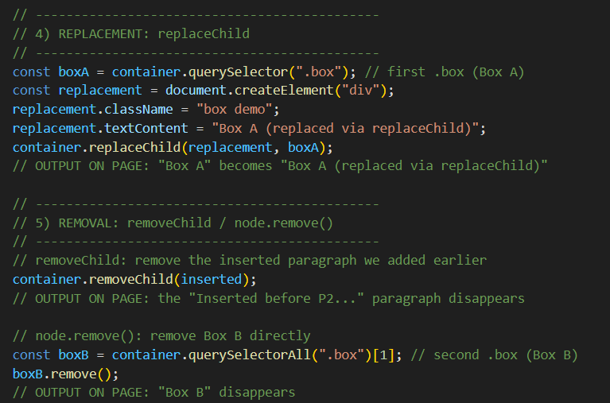
Document Object Model
Example of using DOM Methods in Code

Slide 27
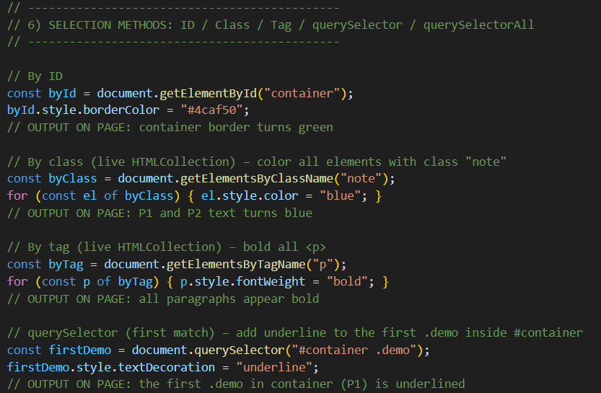
Document Object Model
Example of using DOM Methods in Code

Slide 28
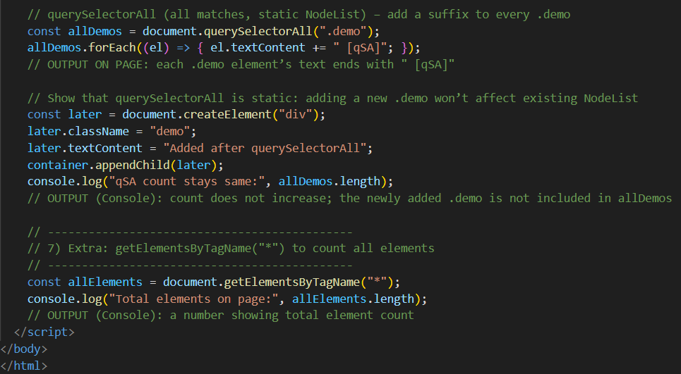
Document Object Model
Example of using DOM Methods in Code

Slide 29
Document Object Model
MCQ
Which is NOT a DOM element access method listed?
A. getElementById
B. getElementsByName
C. getElementsByTagName
D. getElementsByCss

Slide 30
Document Object Model
MCQ
Which is NOT a DOM element access method listed?
A. getElementById
B. getElementsByName
C. getElementsByTagName
D. getElementsByCss

Slide 31
Document Object Model
MCQ
2. To create a new element node, use:
A. document.createElement()
B. document.newNode()
C. element.insertNode()
D. window.createElement()

Slide 32
Document Object Model
MCQ
2. To create a new element node, use:
A. document.createElement()
B. document.newNode()
C. element.insertNode()
D. window.createElement()

Slide 33
Document Object Model
MCQ
3. Which method removes a node directly from the DOM?
A. node.remove()
B. document.prune()
C. detachNode()
D. delete node

Slide 34
Document Object Model
MCQ
3. Which method removes a node directly from the DOM?
A. node.remove()
B. document.prune()
C. detachNode()
D. delete node

Slide 35
THANK YOU
Prof. Pavan A C
Department of Computer Science and Engineering

